Slide 1
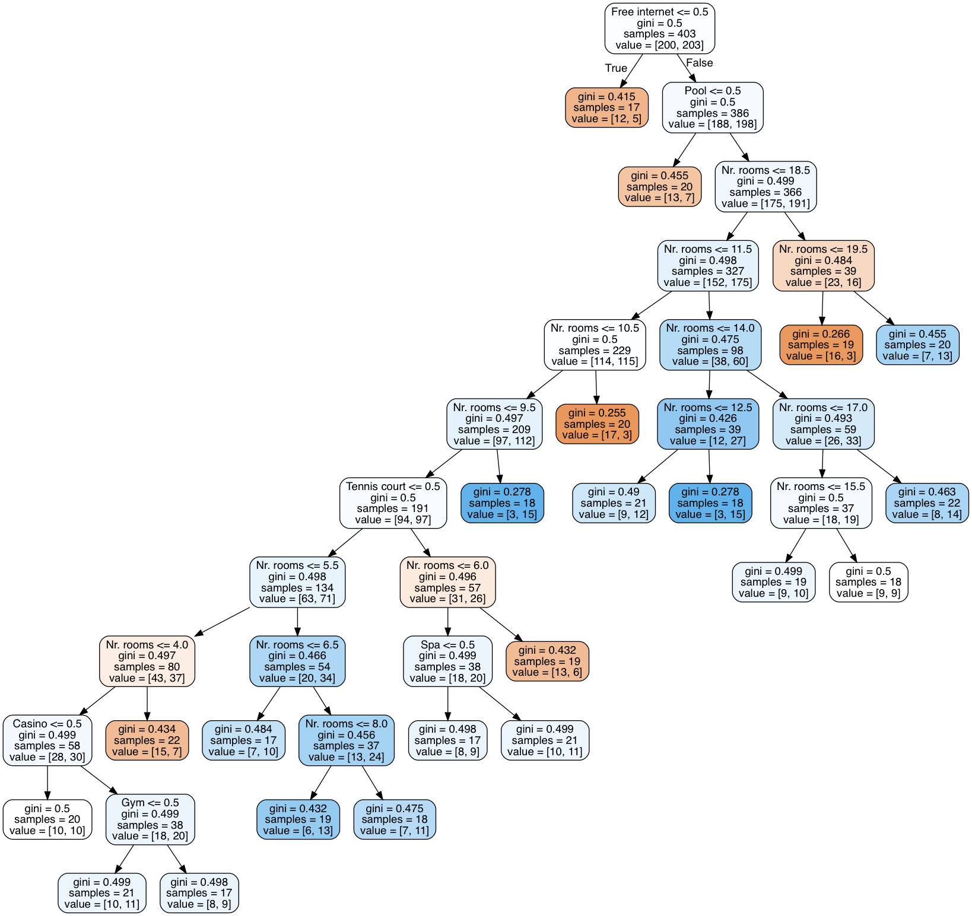
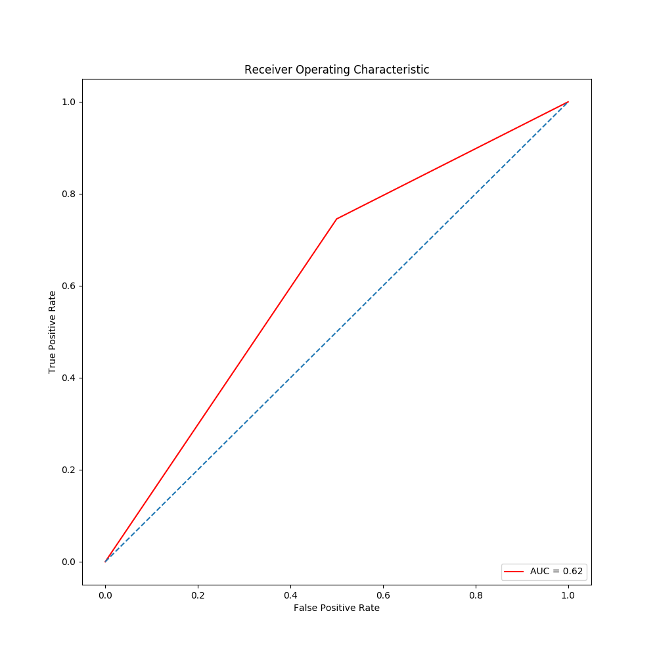


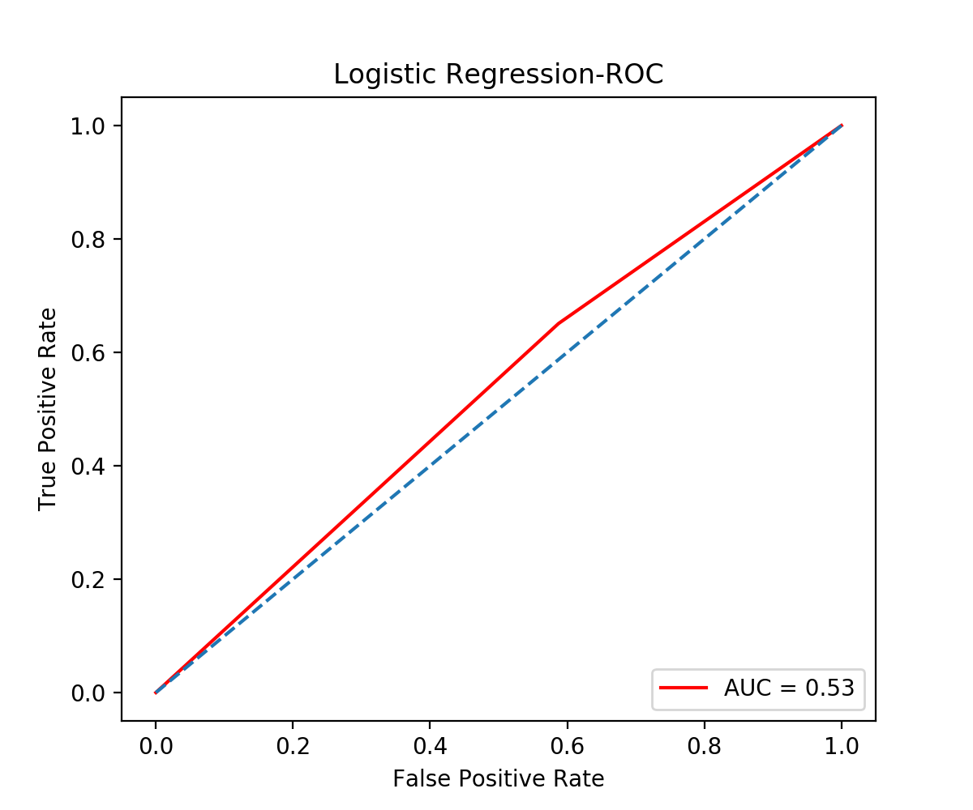
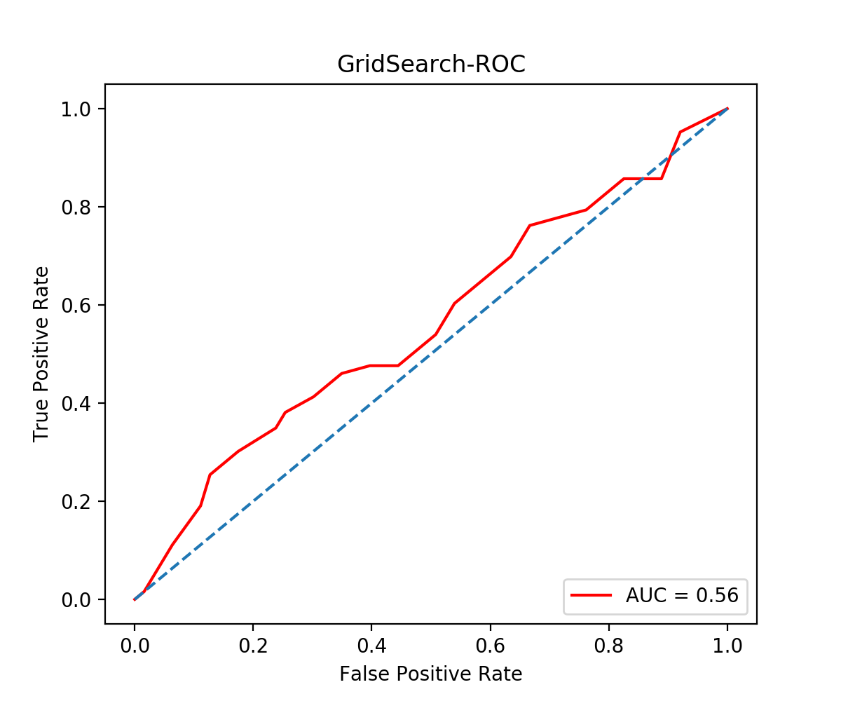
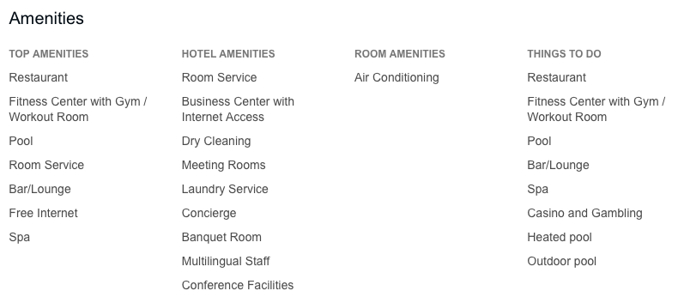

GRCS-08
Hotel Reviews Analysis: Machine Learning
Jiaxin Chen
Abstract
In this project, I applied three Machine Learning approaches to analyze the dataset collected by Sérgio Moro, Paulo Rita and Joana Coelho, Stripping customers‘ feedback on hotels through data mining^{[1]}, predict the customers review score and compare the Receiver Operating Characteristic curve :
Decision Tree;
Default Logistic Regression;
Logistic Regression(GridSearchCV);
Apply Decision Tree to Predict the Customers Review Scores
For this decision tree, I appled the amenities of the hotels as the features( Pool, Gym, Tennis court, Spa, Casino, Free Internet, Number of rooms), and the customers review score as labels.
When the customers review score equals to 1 or 2 or 3, I made the score to category 1, and it means a negative score. When the customers review score equals to 4 or 5, I made the score to category 2 and that means a positive score.
This decision tree made by GINI index. 80% of the raw data as training dataset, 20% of the raw data as test dataset, that means 404 samples for training and 100 samples for testing. Total number of match records is 64, and the accuracy is 0.633663366337.
Introduction to Dataset
This dataset includes quantitative and categorical features from online reviews from 21 hotels located in Las Vegas Strip, extracted from TripAdvisor.
The dataset contains 504 samples and 20 features, include：
Number of reviews, Total hotel reviews, Helpful votes, Score, Period of stay, Traveler type, Member registered year, Pool, Gym, Tennis count, Spa, Casino, Free internet, Hotel stars, Number of rooms, User continent, Member years, Review month, Review weekday, Username, User country.
Default Logistic Regression
vs.
Logistic Regression(GridSearchCV)
Contact Information
jchen24@students.kennesaw.edu
References
Stripping customers' feedback on hotels through data mining: The case of Las Vegas Strip.
Sklearn Decision Tree Classifier [Online].
Sklearn Logistic Regression [Online].
Sklearn GridSearchCV [Online].

